Slide 1
Singularities and Residues

Slide 2
Analytic Function
A function f of
the complex variable z is analytic at a point z0 if it has a derivative at each point
in some neighborhood of z0.
It follows that if f is analytic at a point z0, it must
be analytic at each point in some neighborhood of z0.

Slide 3
Note that the function f (z) = 1/z is analytic at each nonzero point in the finite plane.

Slide 4
An entire function is a function that is analytic at each point in the entire finite plane.
Since the derivative of a polynomial exists everywhere, it follows that every polynomial is an entire function.

Slide 5
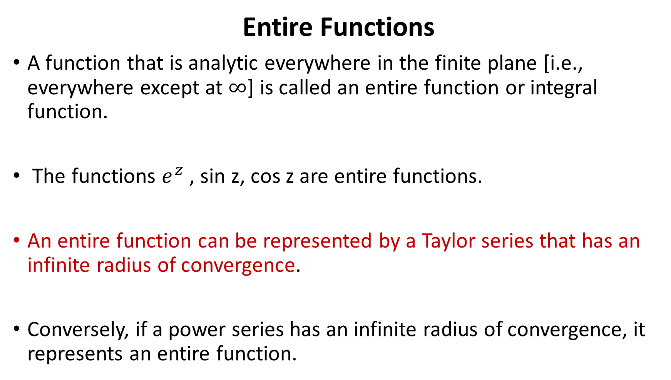
Entire Functions
A function that is analytic everywhere in the finite plane [i.e., everywhere except at $∞$] is called an entire function or integral function.
The functions $e^{z}$, sin z, cos z are entire functions.
An entire function can be represented by a Taylor series that has an infinite radius of convergence.
Conversely, if a power series has an infinite radius of convergence, it represents an entire function.

Slide 6
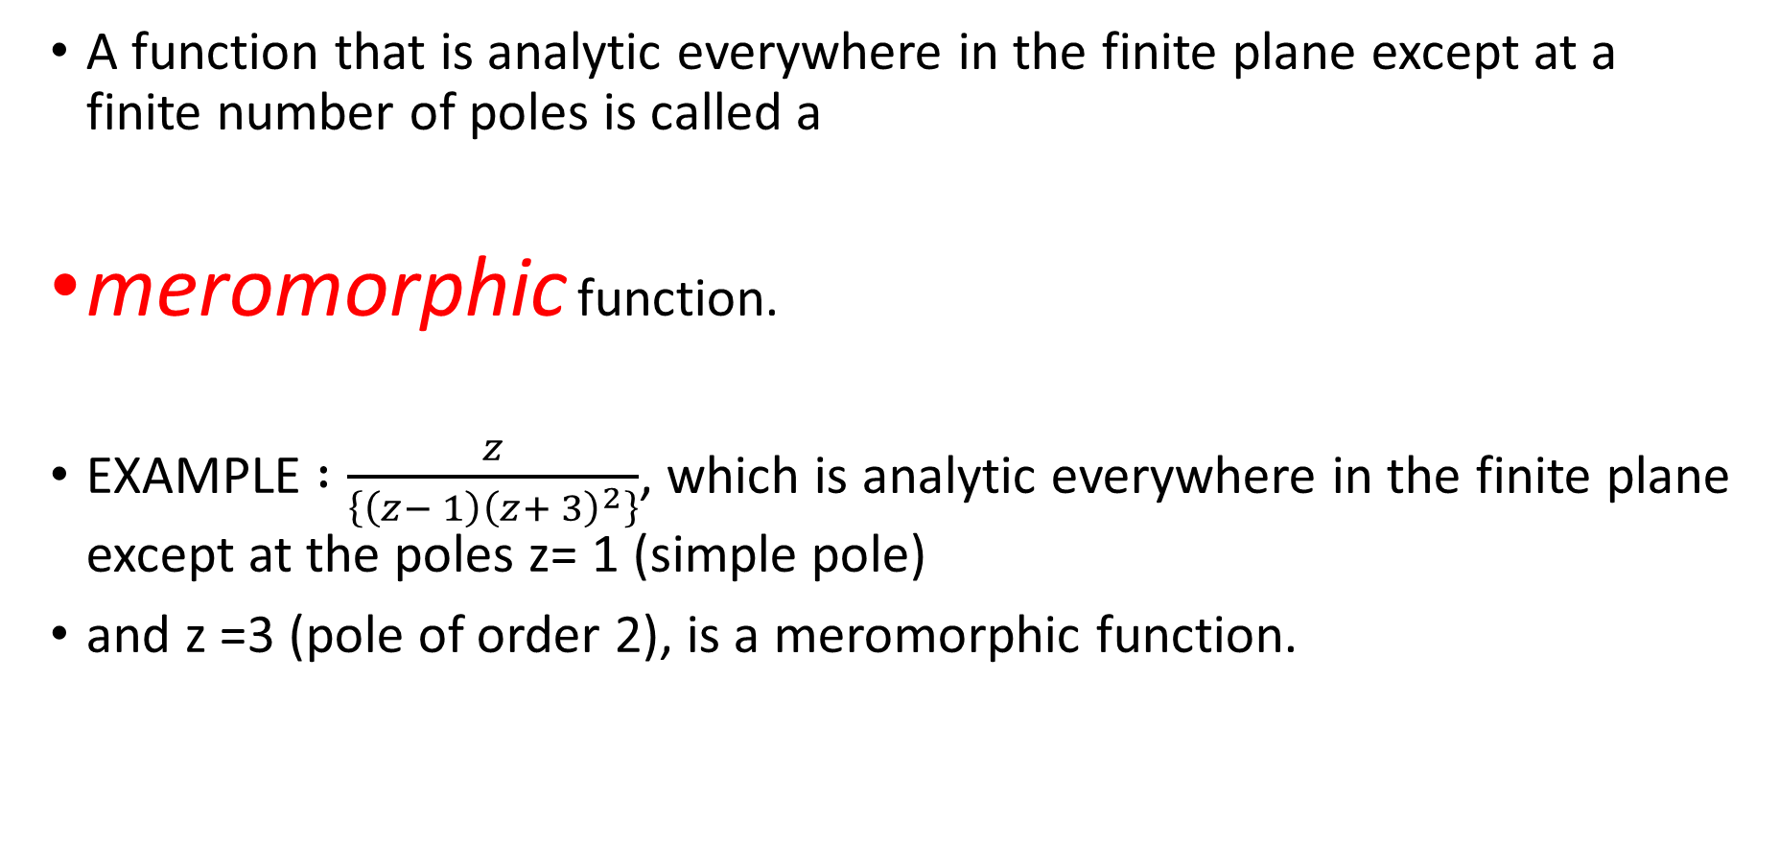
Meromorphic Functions
A function that is analytic everywhere in the finite plane except at a finite number of poles is called a
meromorphic function.
EXAMPLE $:\frac{z}{\left\{\left(z− 1\right){\left(z+ 3\right)}^{2}\right\}}$, which is analytic everywhere in the finite plane except at the poles z= 1 (simple pole)
and z =3 (pole of order 2), is a meromorphic function.

Slide 7
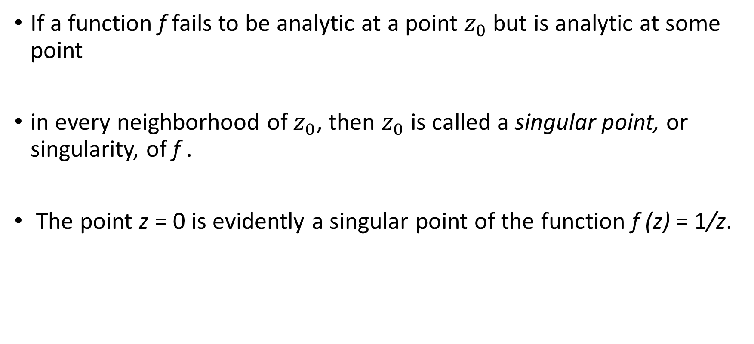
Singularity
If a function f fails to be analytic at a point $z_{0}$but is analytic at some point
in every neighborhood of $z_{0}$, then $z_{0}$ is called a singular point, or singularity, of f .
The point z = 0 is evidently a singular point of the function f (z) = 1/z.

Slide 8
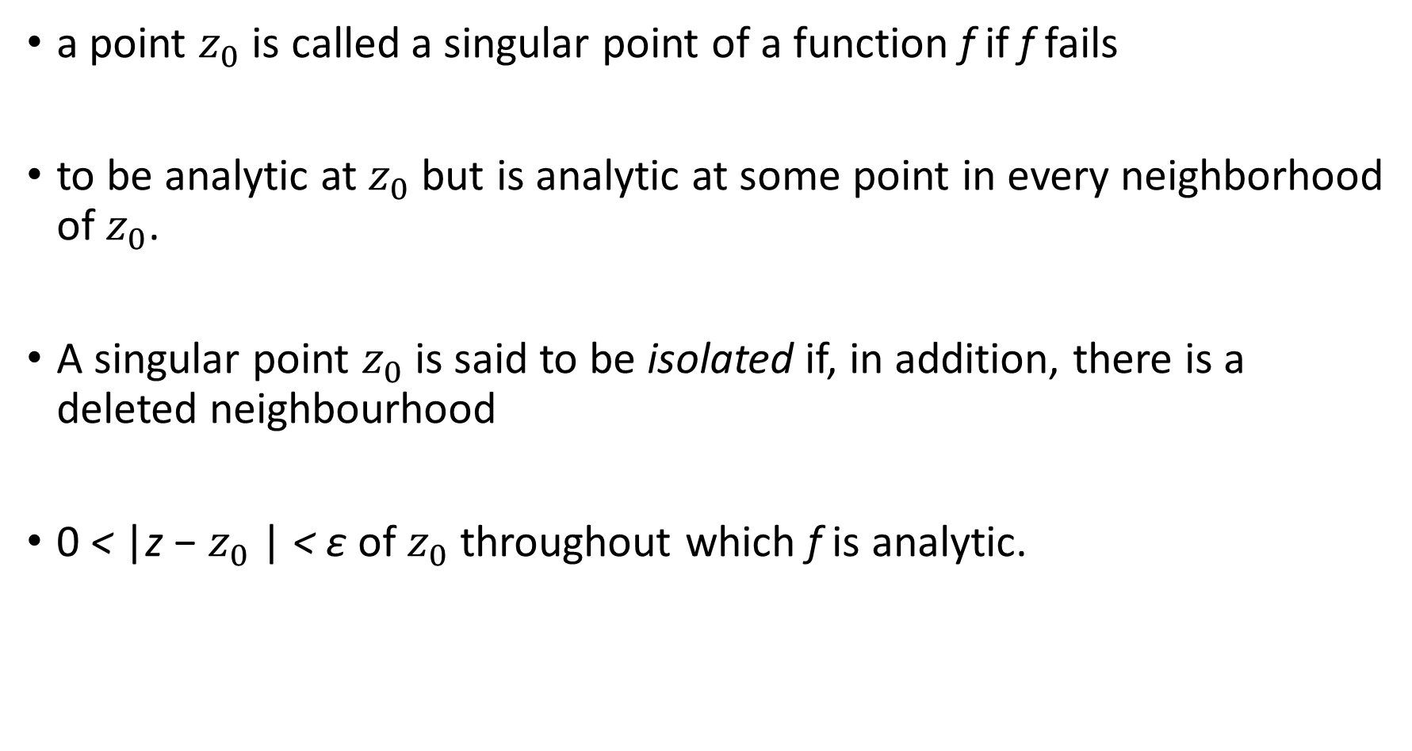
a point $z_{0}$ is called a singular point of a function f if f fails
to be analytic at $z_{0}$ but is analytic at some point in every neighborhood of $z_{0}$.
A singular point $z_{0}$ is said to be isolated if, in addition, there is a deleted neighbourhood
0 < |z − $z_{0}$| < ε of $z_{0}$ throughout which f is analytic.

Slide 9

The function
$\frac{z+1}{z^{3}\left(z^{2} + 1\right)}$
has the three isolated singular points z = 0 and z = ±i.

Slide 10

(this was the case discussed in class) but it is analytic at $z=\frac{1}{n}$
(n = ±1,±2, . . .),
On the other hand ……..
sin⁡(π/z) is also not defined in a neighborhood of the origin
so is not analytic as it is not differentiable there.

Slide 11
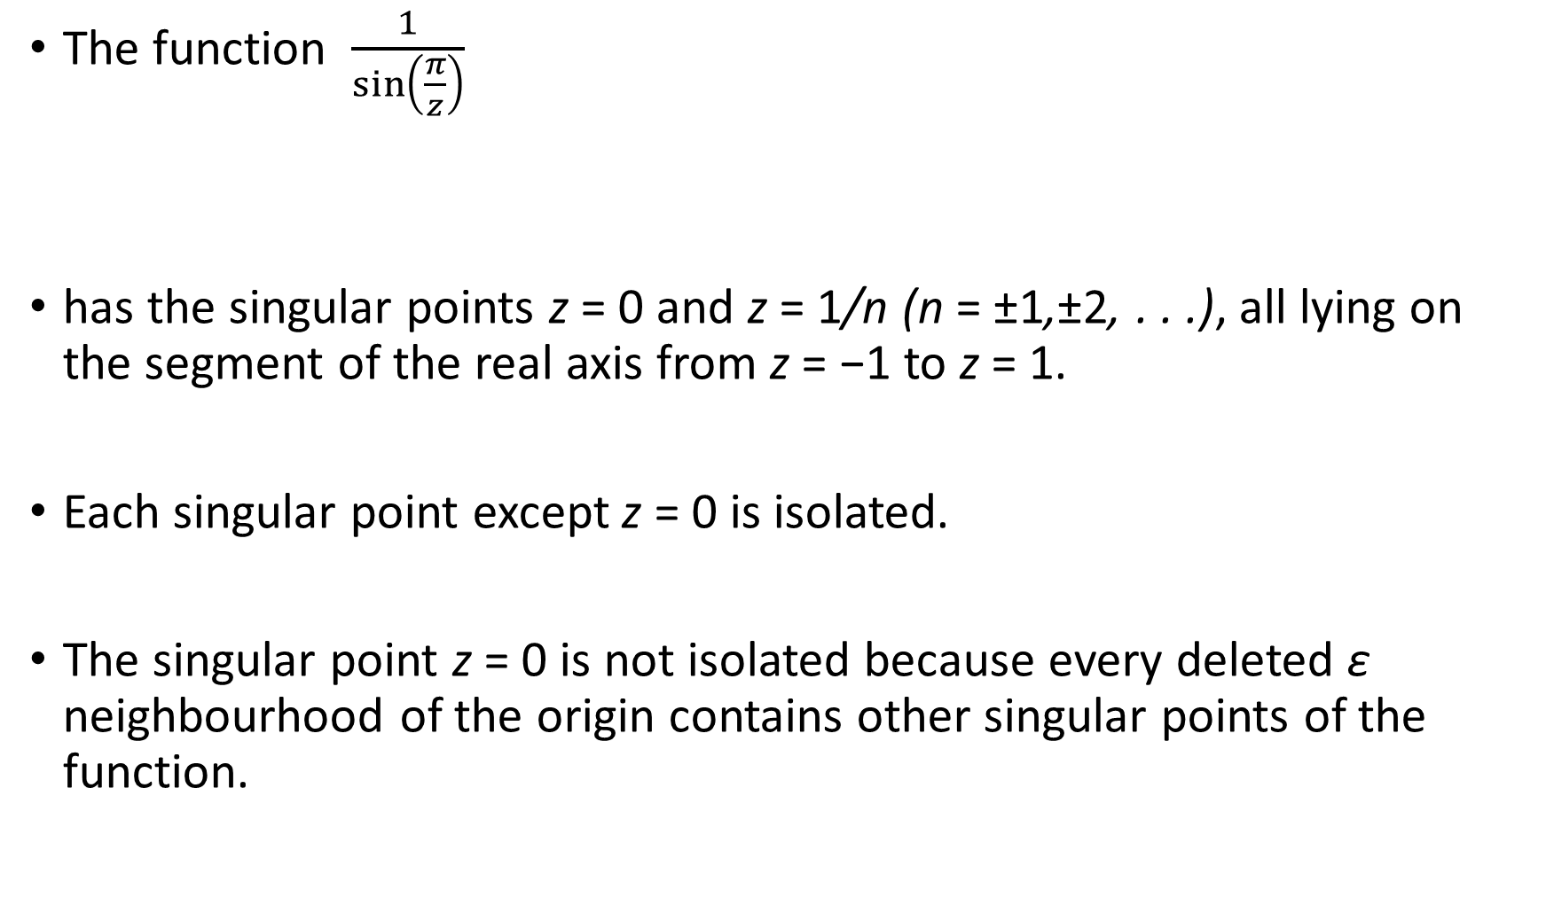
The function $\frac{1}{\sin\left(\frac{π}{z}\right)}$
has the singular points z = 0 and z = 1/n (n = ±1,±2, . . .), all lying on the segment of the real axis from z = −1 to z = 1.
Each singular point except z = 0 is isolated.
The singular point z = 0 is not isolated because every deleted ε neighbourhood of the origin contains other singular points of the function.

Slide 12


Slide 13

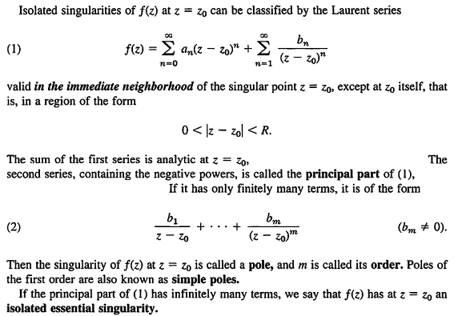

Slide 18

$\frac{sinz}{z}=\frac{1}{z}(z−\frac{z^{3}}{3!}+\frac{z^{5}}{5!}−……….)$=
$1−\frac{z^{2}}{3!}+\frac{z^{4}}{5!}−……….$

Slide 29
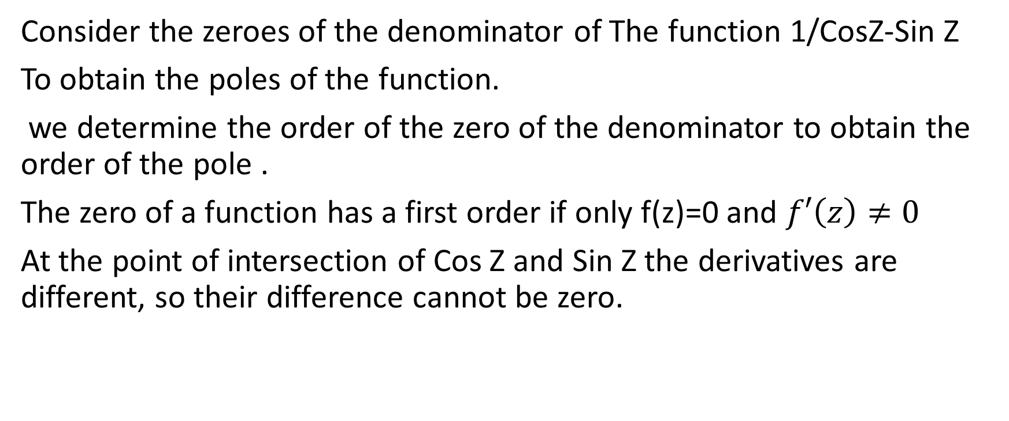
Consider the zeroes of the denominator of The function 1/CosZ-Sin Z
To obtain the poles of the function.
we determine the order of the zero of the denominator to obtain the order of the pole .
The zero of a function has a first order if only f(z)=0 and $f′\left(z\right)≠0$
At the point of intersection of Cos Z and Sin Z the derivatives are different, so their difference cannot be zero.

Slide 34
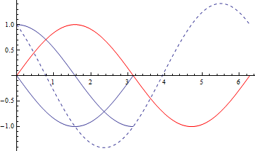

Slide 35
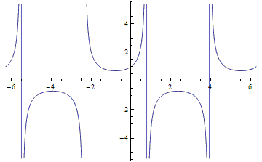

Slide 42
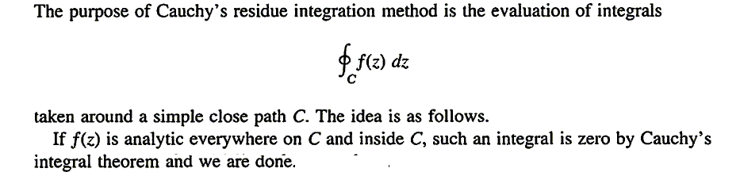

Slide 44
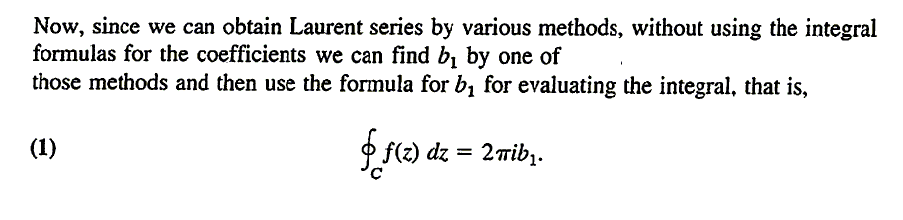

Slide 46
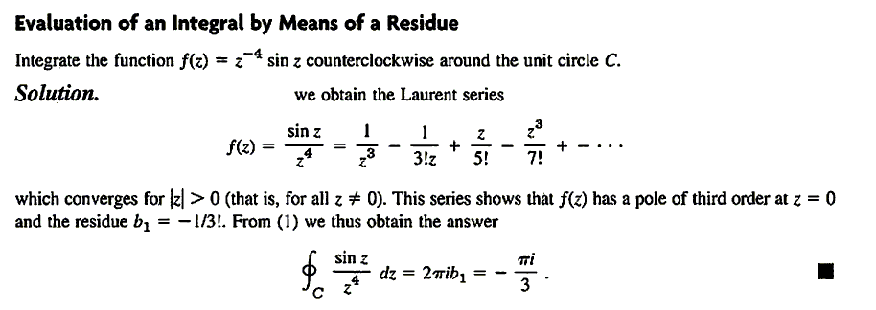

Slide 47
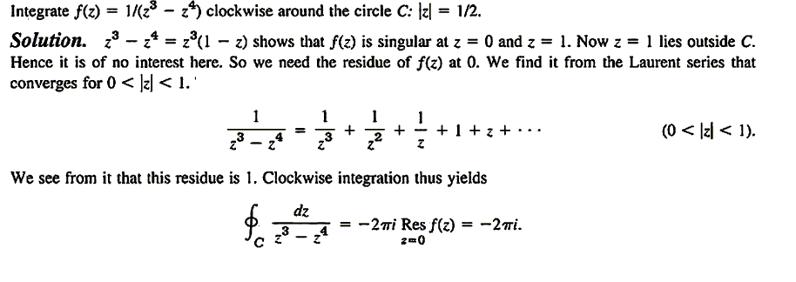

Slide 49
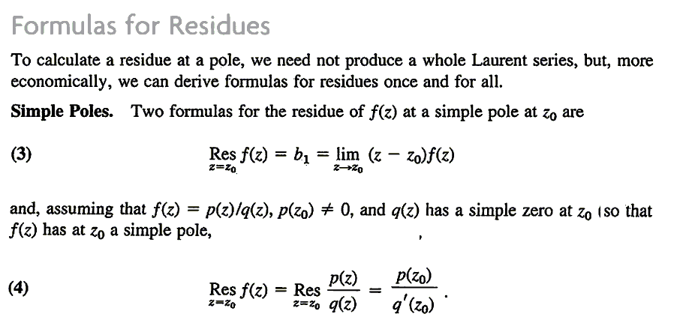

Slide 50
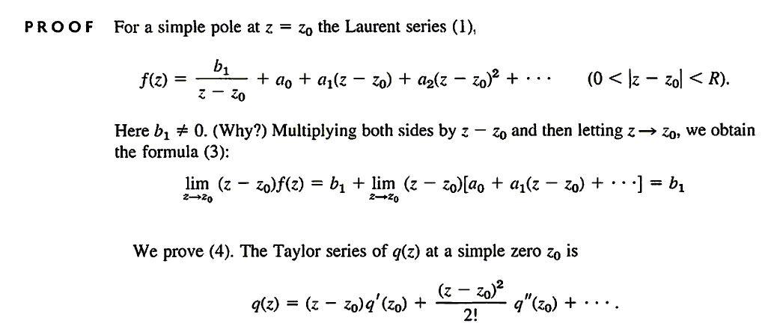

Slide 51
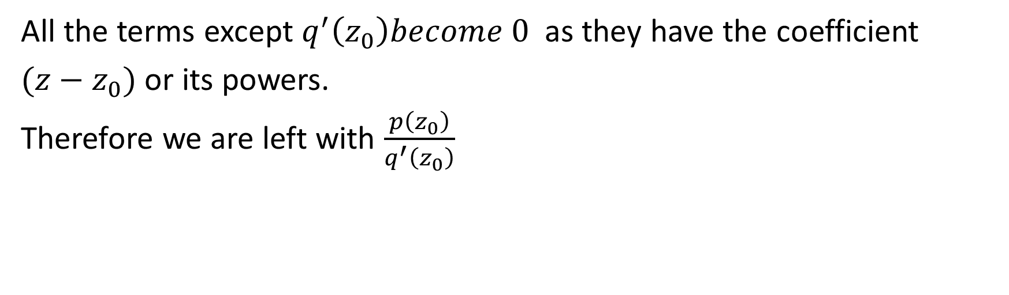
All the terms except $q^{′}\left(z_{0}\right)become 0$ as they have the coefficient
$(z−z_{0})$ or its powers.
Therefore we are left with $\frac{p\left(z_{0}\right)}{q^{′}\left(z_{0}\right)}$

Slide 54
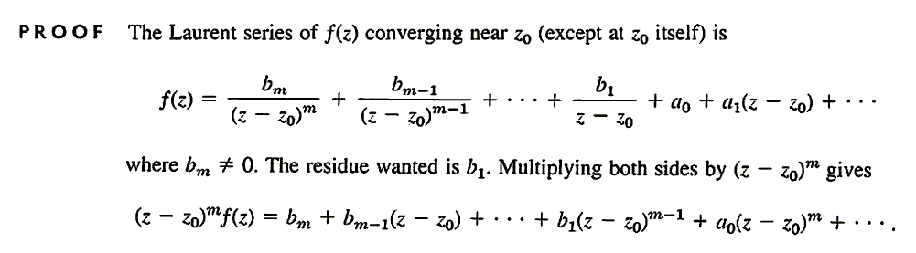

Slide 55
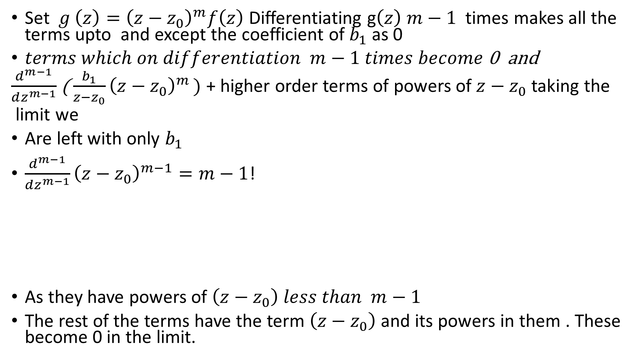
Set $g \left(z\right)={\left(z−z_{0}\right)}^{m}f\left(z\right)$Differentiating g$\left(z\right) m−1$ times makes all the terms upto and except the coefficient of $b_{1}$ as 0
$terms which on differentiation m−1 times become$ 0 and
$\frac{d^{m−1}}{dz^{m−1}}$( $\frac{b_{1}}{z−z_{0}}{\left(z−z_{0}\right)}^{m })$ + higher order terms of powers of $z−z_{0}$ taking the
limit we
Are left with only $b_{1}$
$\frac{d^{m−1}}{dz^{m−1}}{\left(z−z_{0}\right)}^{m−1}=m−1$!
As they have powers of $\left(z−z_{0}\right) less than m−1$
The rest of the terms have the term $\left(z−z_{0}\right)$ and its powers in them . These become 0 in the limit.

Slide 56

Thus in the limit as $z→z_{0}$only $b_{1}$remains.

Slide 58
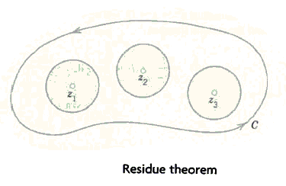

Slide 59
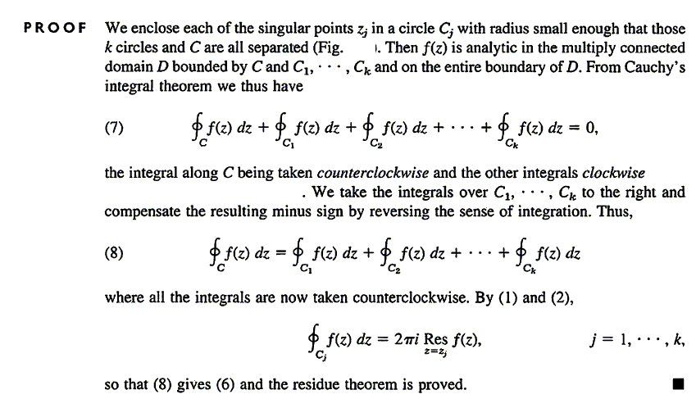

Slide 60
Problems on residues 16.3

